Slide 1
Evaluator of HIV-RT Personnel Competency TOT: Training Overview

Slide 2
Goal of the TOT
To develop a pool of competent evaluators/trainers who will train more evaluators of HIV-RT personnel competency in support of the MOH’s initiative to roll-out tester personnel certification, ensuring qualified, competent testers to perform HIV-RT
Notes:
MOH has an initiative to roll-out tester personnel certification to ensure qualified, competent testers who perform HIV-RT
This TOT (training of trainers) has been developed to support that initiative
The main purpose is to train a pool of competent evaluators who will serve as trainers, in a cascade event (next week), to train more evaluators of HIV-RT tester personnel competency

Slide 3
TOT Objectives
Upon successful completion of this workshop, participants will be able to;
Identify attributes and competencies of an evaluator of HIV-RT personnel competency.
Develop an in-depth understanding of the tester personnel competency assessment tools.
Demonstrate the required skills/knowledge to perform effective tester personnel competency assessments.
Train others to successfully serve as evaluators of HIV-RT personnel competency.

Slide 4
What to Expect from this TOT
This workshop will be:
Prescriptive
Provides activities/tasks/tools for you to use at your sites
Interactive
An opportunity to discuss, interact, and share experiences with fellow colleagues (i.e. learn from each other’s experiences)
Notes:
We have an intense training planned for you.

Slide 5
TOT Agenda Overview
Day 1
Pre-training written assessment
In-depth didactic and hands-on training with tester competency assessment tools and the role/expectations of an evaluator
Days 2 & 3
Practical examples and group work related to evaluator role
Field practical assessment sessions to cultivate and ensure successful assessment and observation practices
Facilitator feedback and open discussions
Notes:
Let’s take a look at the training agenda

Slide 6
TOT Agenda
Day 4
Post-training written assessment
Preparation and group report backs on field practical sessions
Facilitator feedback
Open discussion
Written examination administration
Implementation strategy for roll-out
Workshop evaluation
Day 5
Closing ceremony and certification

Slide 7


Ground Rules / Expectations
Group decides the ground rules and their individual expectations for this workshop!
Notes:
Write their individual expectations on a flip chart and go over the flip chart on the 3rd and 4th day to show how expectations are being met (or not)- this helps to keep facilitators on track and participants motivated and interactive!
Use flip chart to write the groups’ Ground Rules – this reminds everyone of their responsibilities for the week

Slide 8
Ground Rules / Expectations - Suggested
Silence cell phones
Participate 100%
Respect each others’ thinking and value their contributions
Show up and CHOOSE to be present
Staying on schedule is everyone’s responsibility; honor time limits
With transformation, expect anxiety
Stay open to new ways of doing things
Success depends on participation – share ideas, ask questions, draw others out

Slide 9
Agenda Schedule - Housekeeping
Facilitators will present a topic followed by an activity which allows participants the opportunity to practice using the information in small / large groups
There will be one Tea Break and a Lunch Break on Days 1 & 4
There will be only one (heavy) Tea Break on Days 2 & 3
There will be dedicated time for questions and comments each day (Parking Lot)

Slide 10
Evaluation Criteria for Participants
CRITERIA | SCORING
 | LEVEL 1 | LEVEL 2 | LEVEL 3 | LEVEL 4
 | <70% | 70-79% | 80-89% | ≥90%
Training Attendance
Pre-Training Written Examination
Training Content Comprehension
Competency Assessment Skills
Computer Skills / Data Management Comprehension
Post-Training Written Examination
Notes:
Score minimums for each criteria

Slide 11
Competency Levels for Participants
OVERALL COMPETENCY LEVELS Levels 1 – 4 | Level 4 Potential trainer and evaluator of personnel competency. Ready to facilitate and conduct competency assessment using both direct observation checklist and peer-to-peer observation form
 | Level 3 Needs more development as a facilitator and/or an evaluator. Should work under the guidance of more experienced evaluators.
 | Level 2 Does not have acceptable facilitation and/or evaluation skills, but understands the training package well and has inter-personnel skills. May be able to use the checklist to identify deficiencies in personnel competency.
 | Level 1 Cannot facilitate or conduct competency assessment. May be able to assist with logistic support or data management for the QAC. May be able to serve as proctor for written examination.

Slide 12
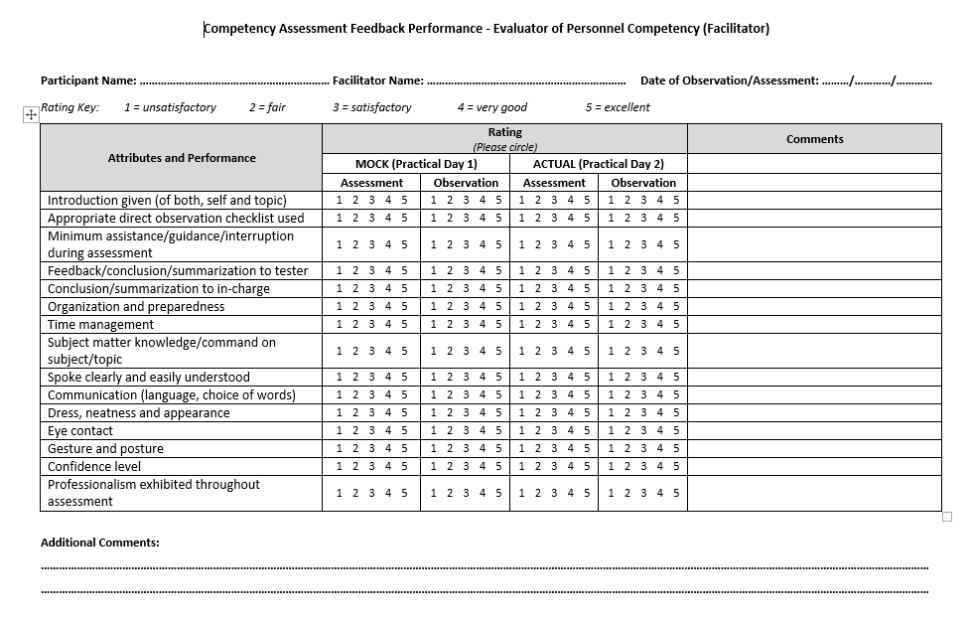
Participant Evaluation Tool – Field Practical
Competency Assessment of Evaluator Performance – Facilitator Feedback
Notes:
Competency Assessment Feedback Performance - Evaluator of Personnel Competency (Facilitator) form: Rename to Competency Assessment (or Direct Observation) of Evaluator Performance – Facilitator Feedback
This is the Feedback form that the facilitator fills out about the Evaluator performance during direct observation, the practical exam component of the Evaluator competency assessment.
It can be used as a checklist of what specific knowledge and competencies Evaluators need to master.
Review each attribute.

